Slide 1
Final writing tips
Should be tailored to the specific class.

Slide 2
Comments and feedback
Feedback request

Slide 3
Some tips
(designed for specific class/questions)
vs.: always spell out versus
Noun/verb should go together
  Can underline full paper
Combine sentences where it makes sense
  Break sentences when they are too long
  Single idea/sentence
  “It is” ; “There are”: weak sentences, rewrite with science as the subject
  Focus paragraphs, often with first sentence as overview
Parallel arguments
locates” => “is located”
Avoid “besides”
Relative terms need a comparison

Slide 4
Tips on tenses
Herczeg approach:
  observations+data reduction in past tense, everything else in present tense
    Citations to old papers: it depends on how they are being cited
    “Galaxies are large”: usually present tense when describing the universe
    Early universe: not sure! That was really in the past!
A different approach, from a friend:
  What we did (data reduction, analysis) in past tense.
    The section of Observation and some parts in the results will be in past tense
    if we want to describe our modeling approach, we usually write as “We applied xx model to...")
  Description of the results (what we found) is usually in present tense.”

Slide 5
Big picture tips
Be direct
  Say what you mean
  Don’t be sensationalist, but be interesting
Don’t do everything
  Cut papers down to size
    nobody reads 20 page papers (and definitely not 30 page papers)
  Focus your arguments
    use appendices for random tangents and barely relevant details

Slide 6
Resources
Common Mistakes in Writing Astronomy and Physics Literature in English
  https://arxiv.org/abs/1011.5973
  Mostly in Chinese
Writing Scientific Papers in Astronomy
  https://arxiv.org/abs/2110.05503
Writing Centers
  https://owl.purdue.edu/
  https://sites.duke.edu/scientificwriting
Each other!
  Share drafts and proposals!

Slide 7
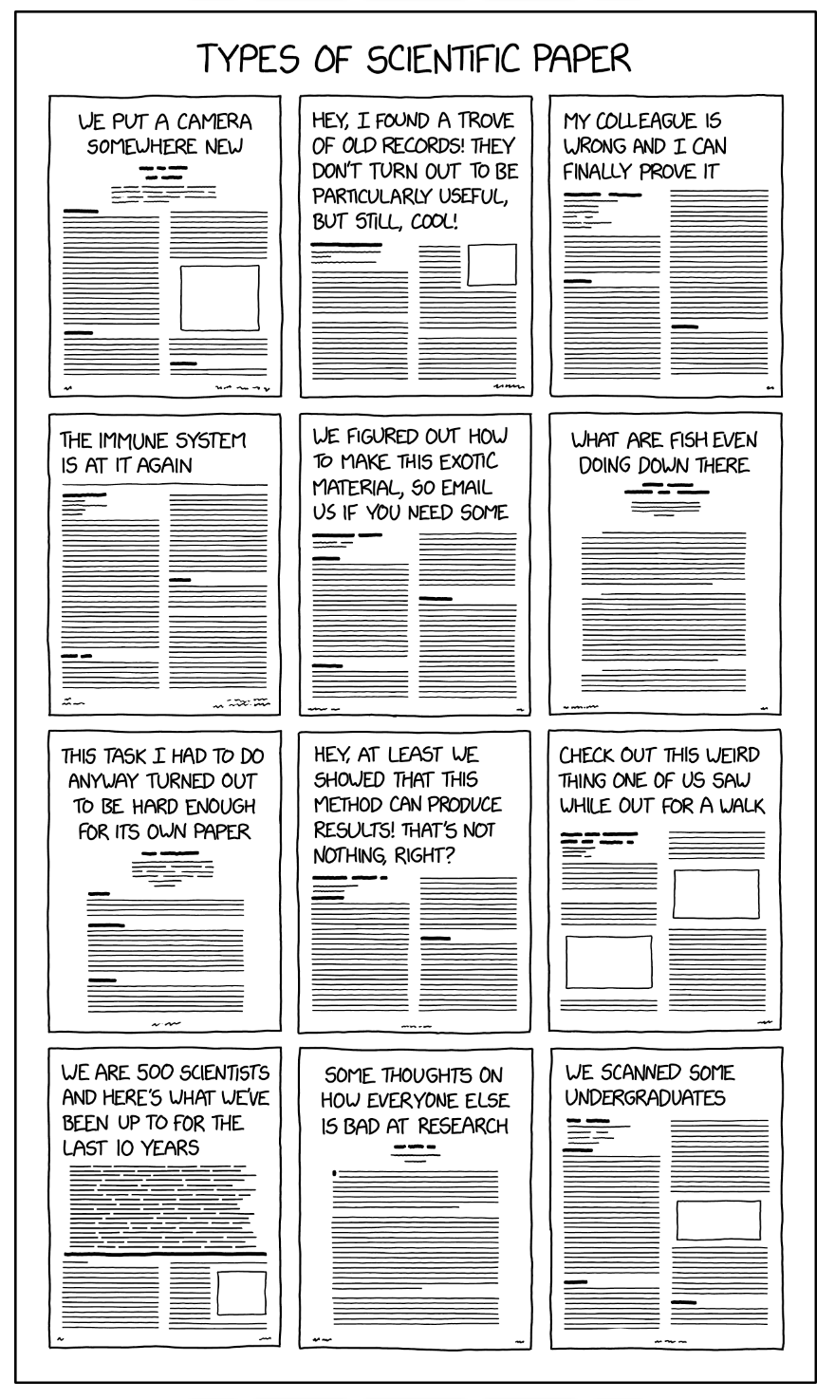
Idea generation and types of papers: https://xkcd.com/2456/
Where do ideas come from?
New capabilities
Creative looks at old ideas
Improving techniques
Parts of paper that don’t fit
Weaknesses in logic
Sources for new ideas include (a) gaps in logic in your work and papers of others, and (b) ideas generated by your paper.
Better editing will improve
your idea generation!

Slide 8
Outline
Outline sections and paragraphs
  Outline with plots
  Let the reader see the outline
    Section/sub-section headings
    Introductions to sections/subsections, even paragraphs
Tell a story
  Every section, paragraph, and plot has a story
Inverse pyramid
  Big concepts come first
  Introduce what will come next

Slide 9
Edit!
Edit your own work heavily
  Write quickly!
  Thesaurus when editing
  Spend 10x as much time editing as writing
Logical flow
Grammar
Keep science and grammar edits separate
Figures: spend time editing them!
  Large fonts
  Clear point that can be seen
Techniques:
Read out loud
Rely on others to edit
  Can always share drafts with each other
Underline looking for different things

Slide 10
Time allocation and your future
Write quickly!
  Take your time in editing
If you have been at your desk for an hour and have not made progress, move on to something else
  This applies to writing and everything else
  Your time is precious
Don’t be paralyzed by perfection
  Perfect is the enemy of the good
  Don’t drive yourself crazy
Focus on logic, not grammar
Work with others, accept criticism and feedback
  Other people will strengthen your work
  Identify flaws in logic
  Add expertise that you lack – you cannot be an expert in everything
Enjoy sharing your discovery with others
  Own your PhD topic. It’s yours, know it and love it!
  Goal: you are the expert teaching your advisor

